Slide 1
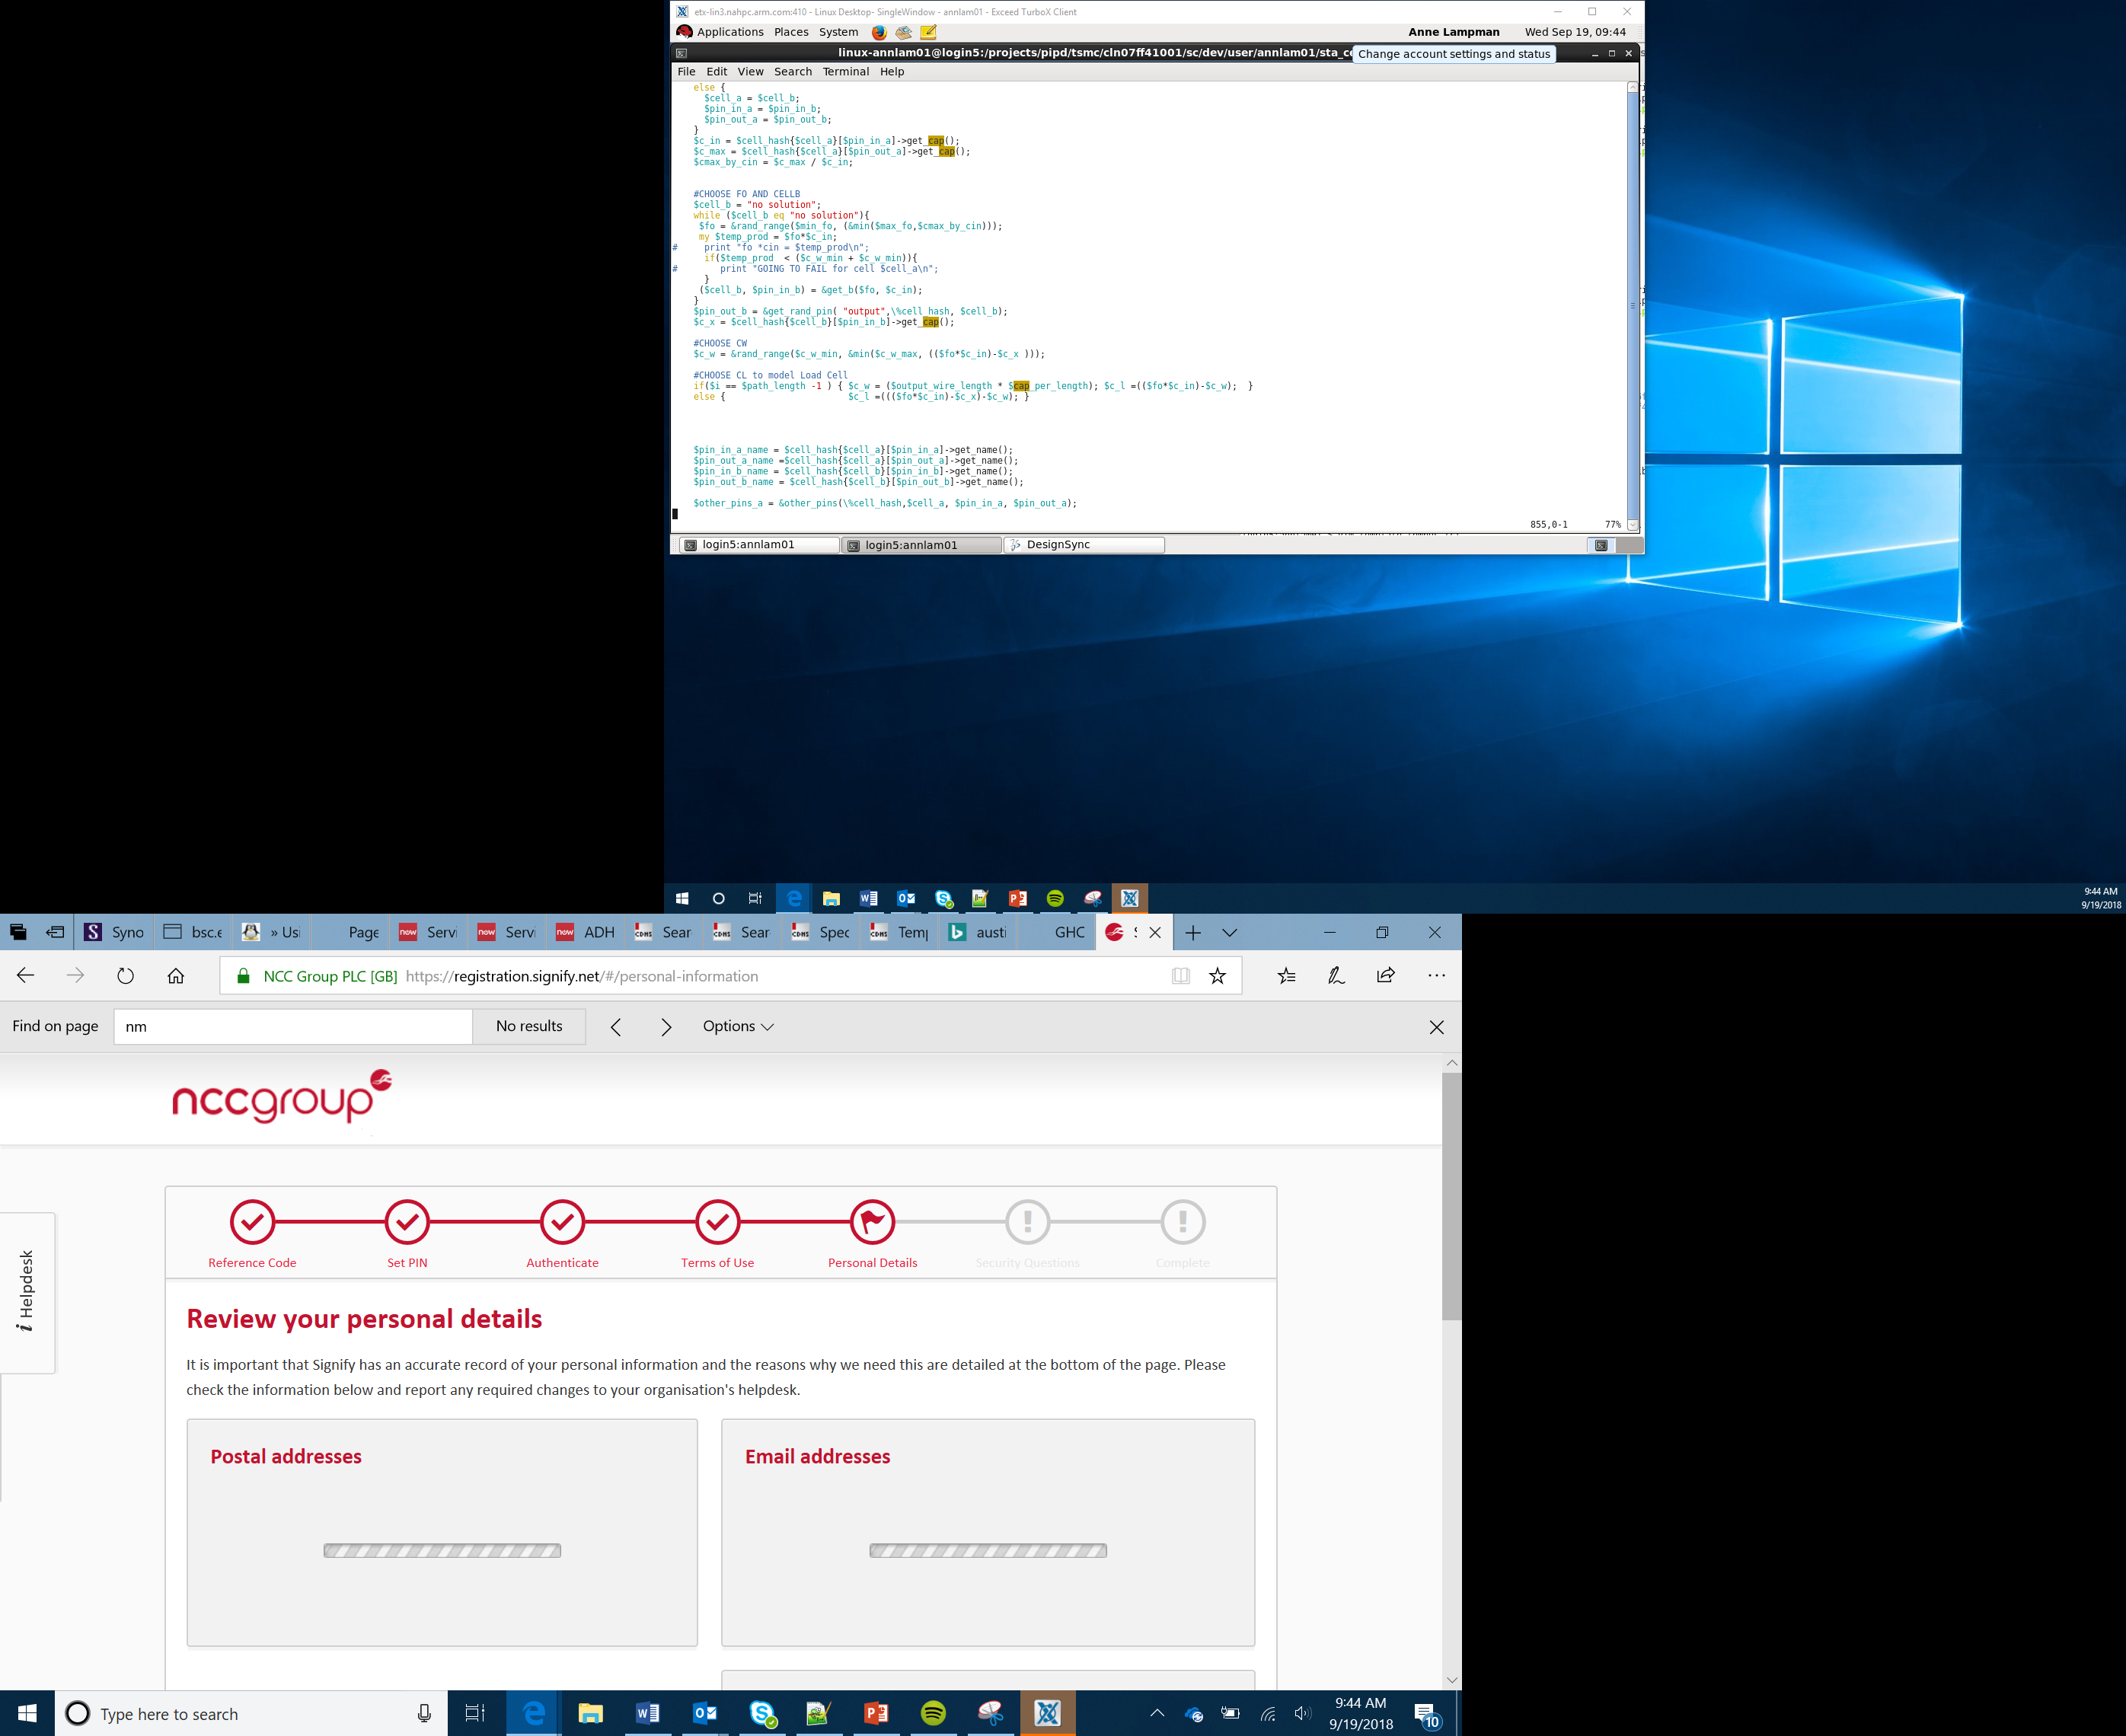

micro:pet Project
Lessons 11-12

Slide 2
Lesson 5

Slide 3
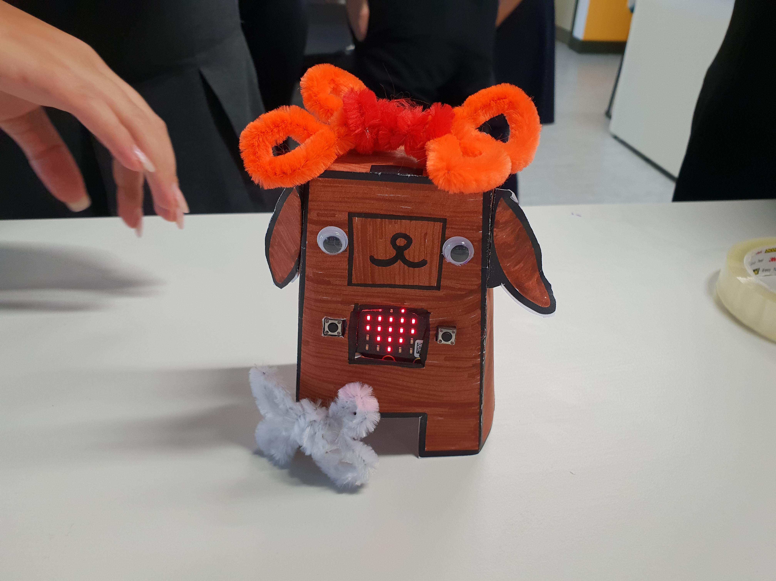
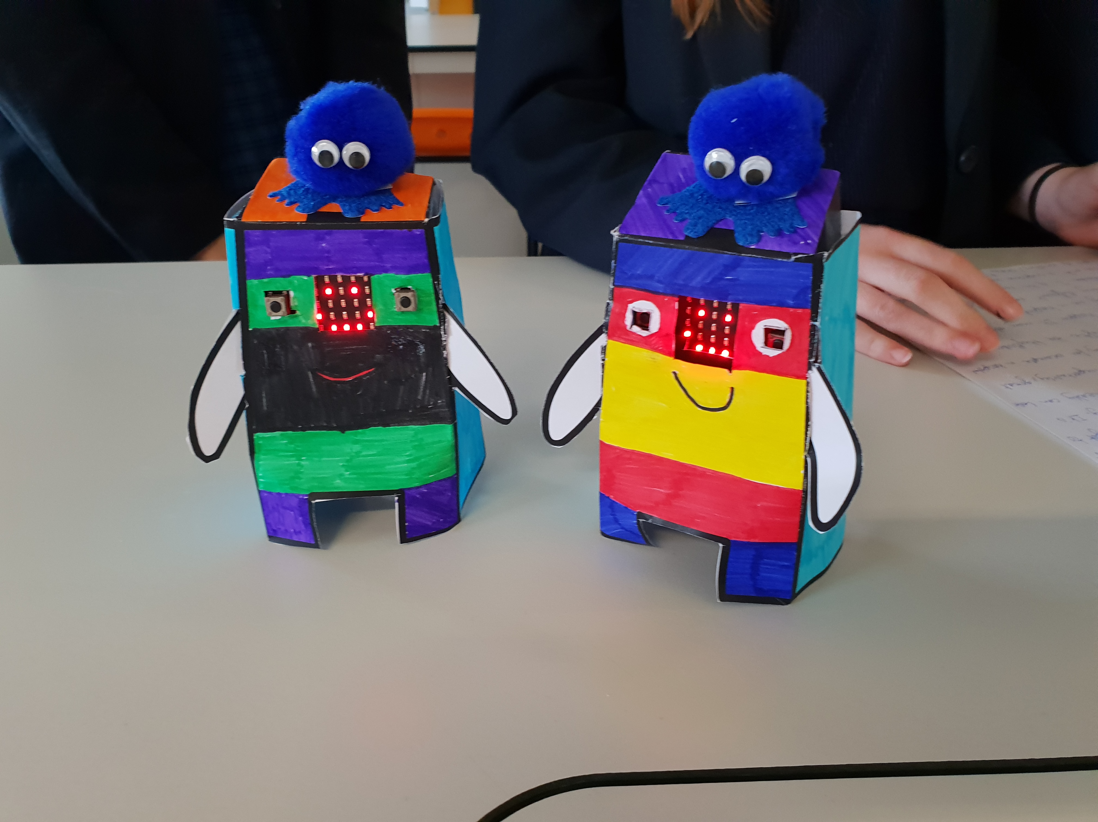
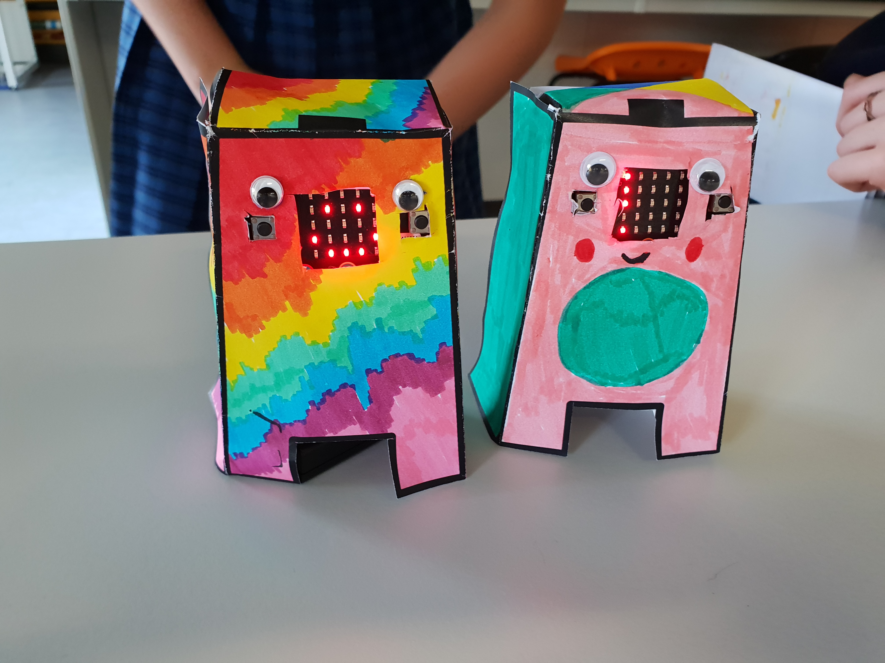
Setting the Scene
Loneliness is a real problem for children staying in hospitals for a long time
You need to create a digital pet that they can play with and keep them company while they stay in hospital

Slide 4
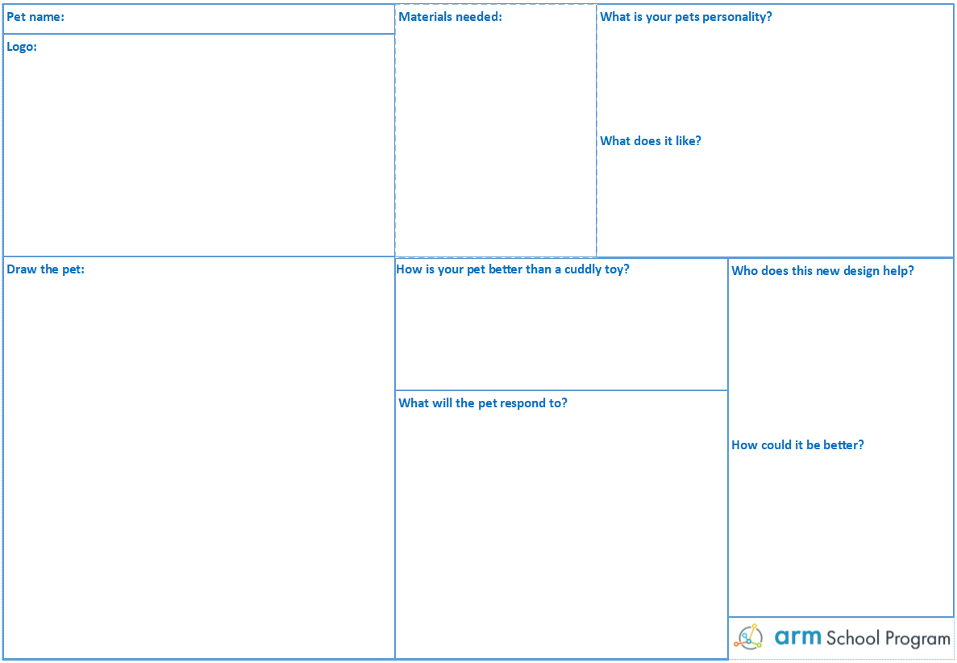
The Design Template
Fill this in first!
Add to it as you go along

Slide 5
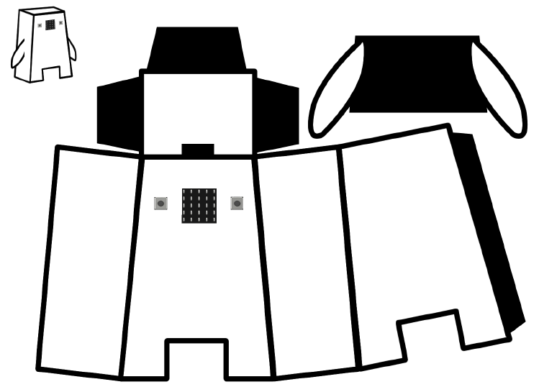
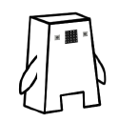
micro:pet Net
The net
Design the pet and its features/functionality
Use cases
Going beyond the net template
Presenting you product – the elevator pitch
Be creative!

Slide 6
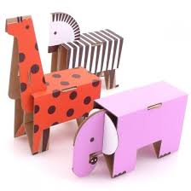
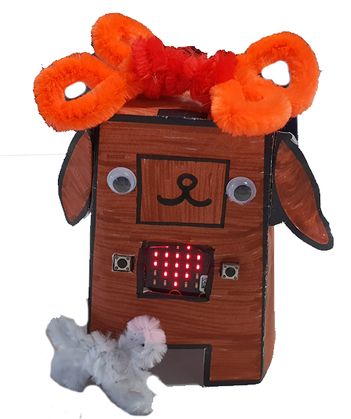
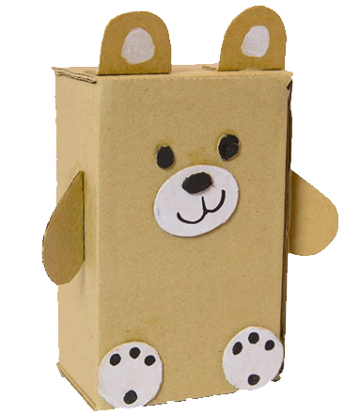
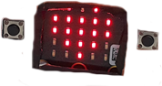
Building the Pet
Make sure the micro:bit and battery fit inside
Make sure the USB port is accessible
Be creative!

Slide 7
Success Criteria
The pet must:
Look like a friendly pet (be creative)
Be robust enough to be played with
Contain a micro:bit that users can interact with
Have a face to express emotions when interacted with
Have two or more interactions programmed so it behaves like a pet to keep the user entertained

Slide 8
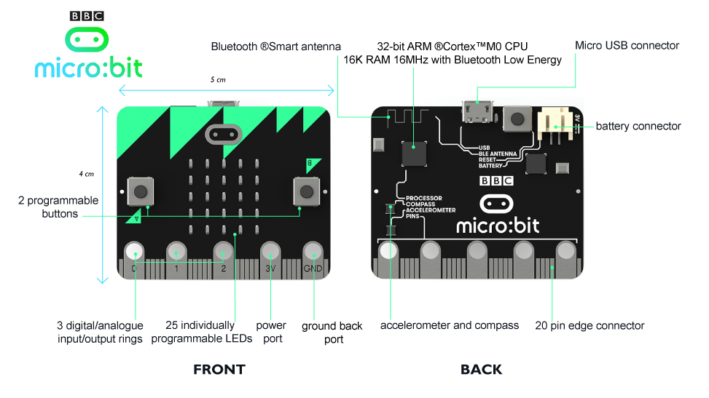

Slide 9
Input, Process, Output (IPO)
Input
Process
Output
Sensors (produce data)
Temperature sensor
Light sensor
Accelerometer
Compass
Bluetooth
Buttons
Takes input data
Does something with the data
Stores the data
LEDs
Radio

Slide 10
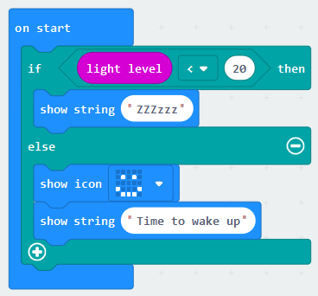
Input, Process, Output (IPO)
Input
Process
Output
Light sensor would detect the light level
Takes input data from the light sensor to determine which branch of the if statement to take
LEDs would output either ZZZzzz or ☺ followed by “Time to wake up” depending on the ambient light level

Slide 11
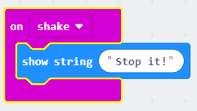
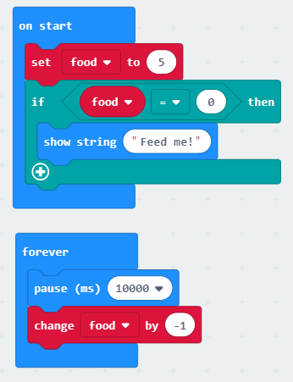
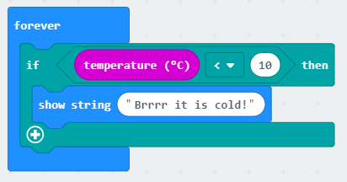
Some Example Interactions:

Slide 12
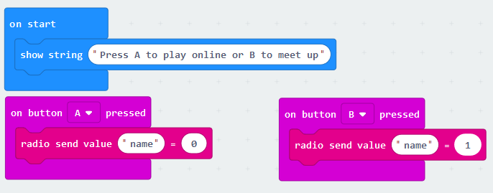
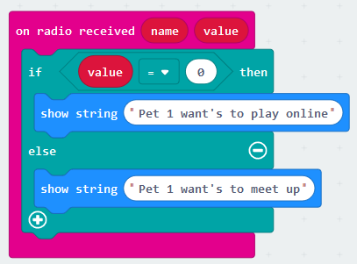
Example interaction between 2 pets
Pet 1
Pet 2

Slide 13
Design Some Interactions
Using the IPO worksheet, design some micro:pet interactions of your own
Input
Process
Output

Slide 14
Lesson 6

Slide 15
Success Criteria
The pet must:
Look like a friendly pet (be creative)
be robust enough to be played with
contain a micro:bit that users can interact with
have a face to express emotions when interacted with
have two or more interactions programmed so it behaves like a pet to keep the user entertained

Slide 16
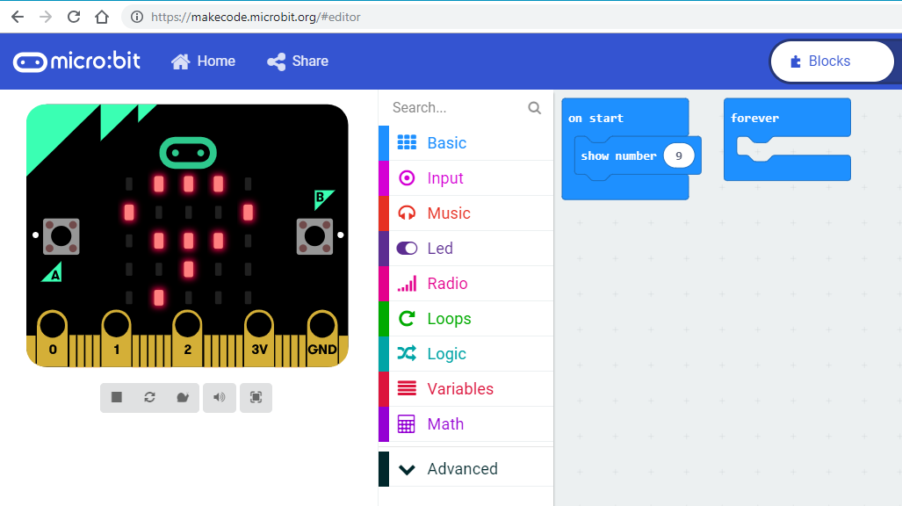
Programming the micro:bit

Slide 17
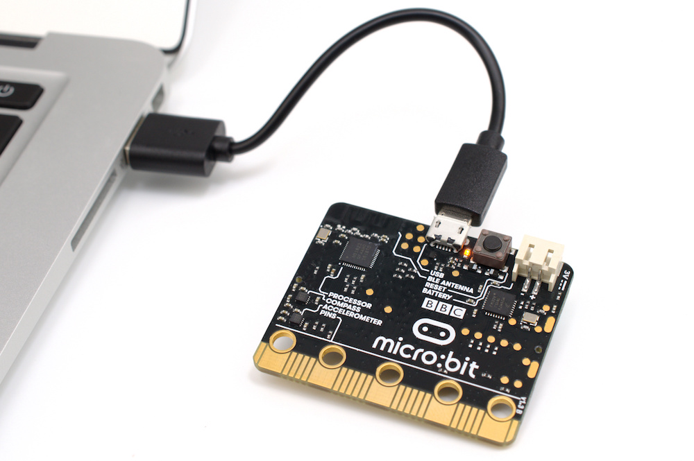
Make a program on MakeCode
Download the .hex to the PC
Transfer the .hex to the micro:bit

Slide 18
Some Ideas
Here are some possible ideas that could be programmed for your pet:
Reacting to playing/shaking (accelerometer)
Feeding (every few hours)
Needing attention (gets lonely if not interacted with frequently)
Sleeping and waking (light sensor)
Reacting to temperature (temperature sensor)
Mini games

Slide 19
Working in Parallel
Programming the Pet
Elevator Pitch (Marketing)
Designing/Making the Pet
Complete the design sheet
Gather the materials
Make the pet
Add the micro:bit
Test the pet
Evaluate
Improve
Plan the interactions
Program the micro:bit
Test the functionality
Add the micro:bit to the pet
Test the pet
Evaluate
Improve
Write the elevator pitch based on the designs
Create a logo

Slide 20
Elevator Pitch and Logo
A short (1 minute) sales pitch
Can include a presentation (include the logo)
Should include:
What the micro:pet is called
What its interactions are
How it helps the user

Slide 21
Elevator Pitch and Logo
A short (1 minute) sales pitch
Can include a presentation (include the logo)
Should include:
What the micro:pet is called
What its interactions are
How it helps the user

Slide 22
Project Evaluation and Reflection
How did you find the project?
How did your group work together?
Did you get everything done?
What would you do differently next time?

